Slide 1
Continuous Delivery to the PowerShell Gallery in 5 minutes
Rob Sewell @sqldbawithbeard https://sqldbawithAbeard.com RobSewell.Info
Notes:
Let’s go on a journey

Slide 2
TODAY’s TO DO LIST
GET UP
Drink Coffee
Create Continuous Delivery Process for Delivering Modules to the PowerShell Gallery
In only 5 minutes ☺
Rob Sewell @sqldbawithbeard https://sqldbawithAbeard.com RobSewell.Info
Notes:
All we have to do is set up some CD to the PowerShell Gallery in 5 minutes – because we are all busy

Slide 3
Why Module?
Ps1 scripts EVERYWHERE!!
Use them in other scripts
Share them
Modularity
Only export functions user needs
Rob Sewell @sqldbawithbeard https://sqldbawithAbeard.com RobSewell.Info
Notes:
Modules make life easier.
Everyone can use them
We have some control over what is happening
We can provide security using them with JEA

Slide 4
Why PowerShell Gallery?
Public or Private Nuget Repository
Share your Modules
Centralise deployment of Modules
PowerShell Gallery is safe and secure
Rob Sewell @sqldbawithbeard https://sqldbawithAbeard.com RobSewell.Info
Notes:
Centralised place to hold our Modules
One source of truth
Easy to build in CI/CD and Version

Slide 5
What do we need?
Plaster – Install-Module Plaster
Pester – Install-Module Pester -Force (even though it is installed by default)
Rob Sewell @sqldbawithbeard https://sqldbawithAbeard.com RobSewell.Info
Notes:
We need Plaster to set up a framework – Use Install Plaster to get it from the Gallery
We need Pester to TDD – Install from Gallery with Force as we want the latest version

Slide 6
What do we need?
Plaster – Install-Module Plaster
Pester – Install-Module Pester -Force (even though it is installed by default)
GitHub Account
VSTS account
We won‘t have time for much detail!!
Rob Sewell @sqldbawithbeard https://sqldbawithAbeard.com RobSewell.Info
Notes:
GitHub Account for Source Control
VSTS Account for Build and Release
This is all free

Slide 7
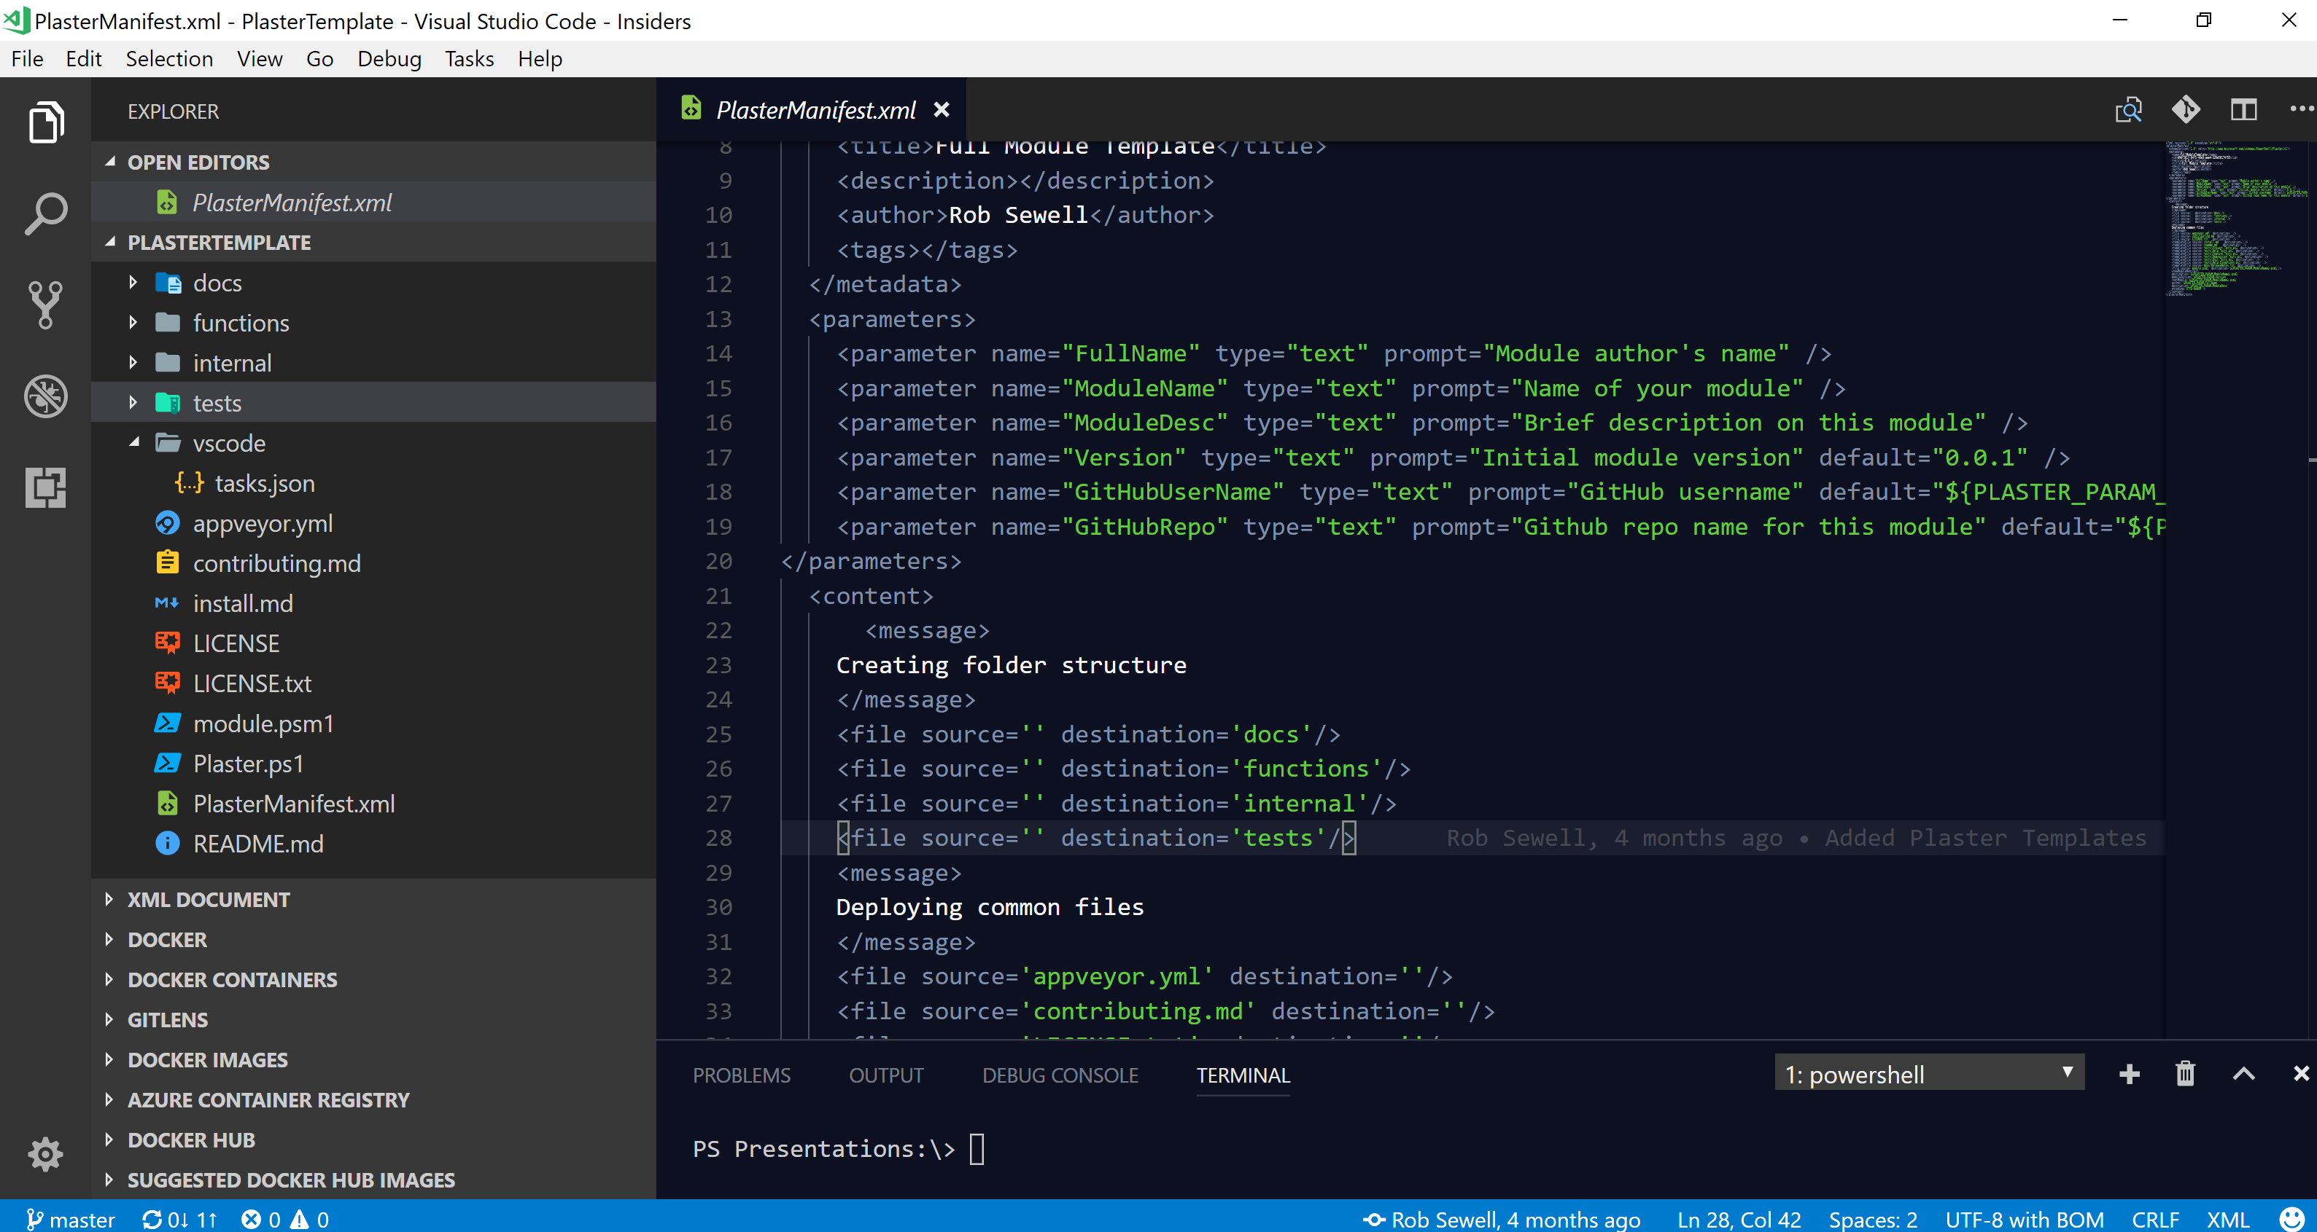
Plaster
Rob Sewell @sqldbawithbeard https://sqldbawithAbeard.com RobSewell.Info
Notes:
Good tests can…
Set up a framework with folders and parameterised content
Use the PlasterManifest.xml file to define what we want

Slide 8
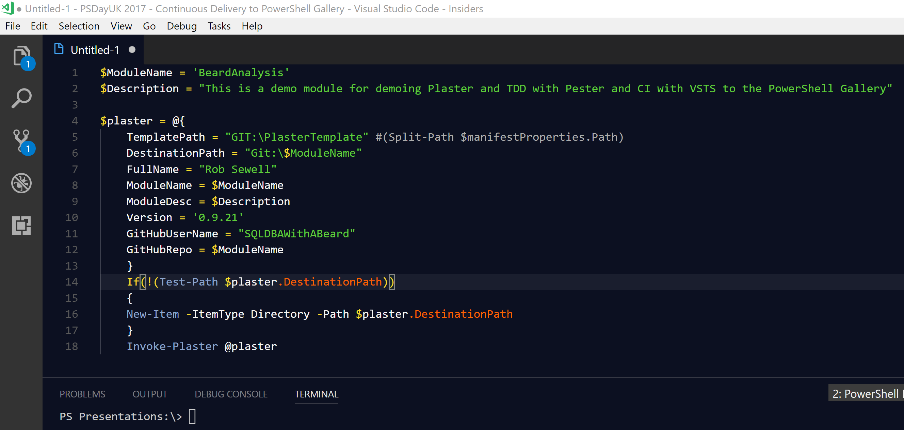
Plaster
Rob Sewell @sqldbawithbeard https://sqldbawithAbeard.com RobSewell.Info
Notes:
Create our Module folder with Invoke-Plaster
Provide the Parameters up fron or answer the questions

Slide 9
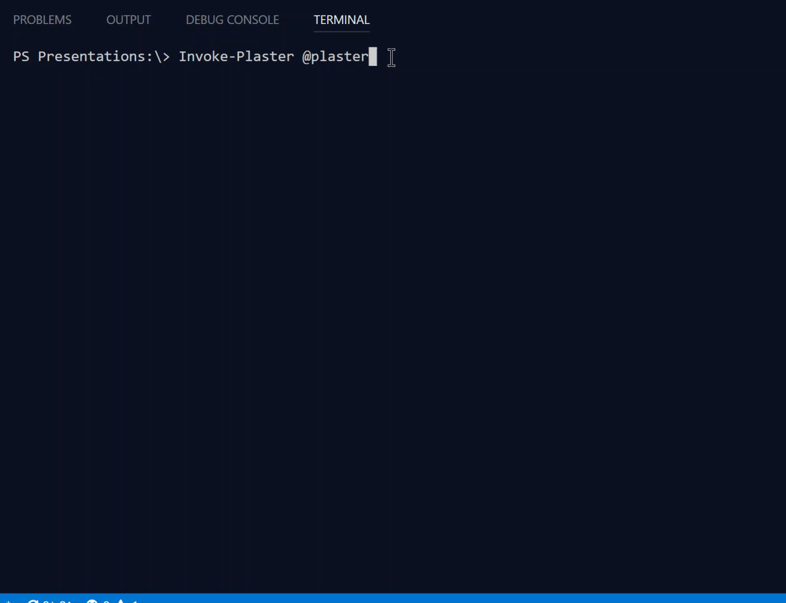
Plaster
Rob Sewell @sqldbawithbeard https://sqldbawithAbeard.com RobSewell.Info
Notes:
Plaster creating our framework

Slide 10
Pester
Write Test Run Test Fail Test
Write Code Run Test Pass Test
Repeat
Rob Sewell @sqldbawithbeard https://sqldbawithAbeard.com RobSewell.Info
Notes:
Good tests can…
Verify the code is working correctly
Prevent future regressions
Document the code’s behaviour
Provide design guidance
Support refactoring
https://www.devmynd.com/blog/five-factor-testing/

Slide 11
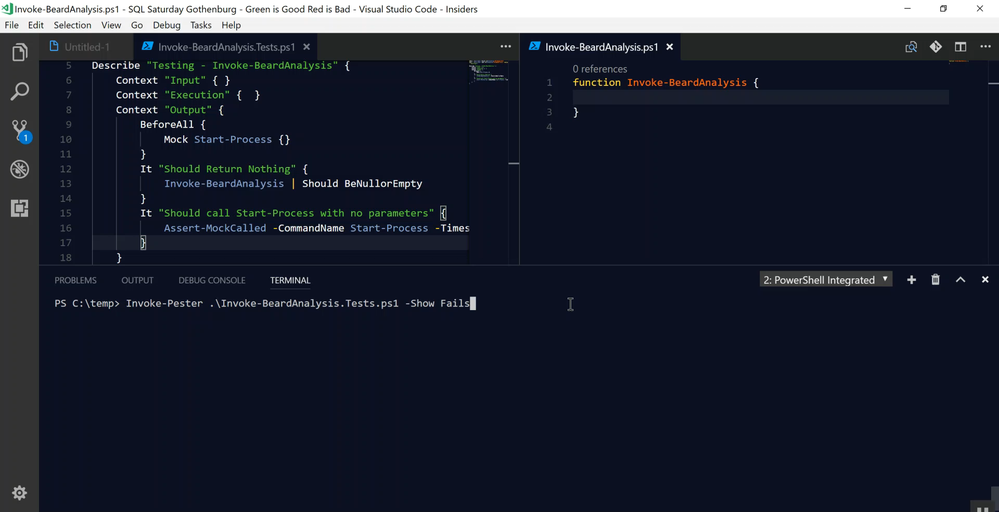
Pester
Rob Sewell @sqldbawithbeard https://sqldbawithAbeard.com RobSewell.Info
Notes:
Write test – we can use mocking in Pester
Run Test it fails
Write Code
Run Test it passes
Repeat

Slide 12
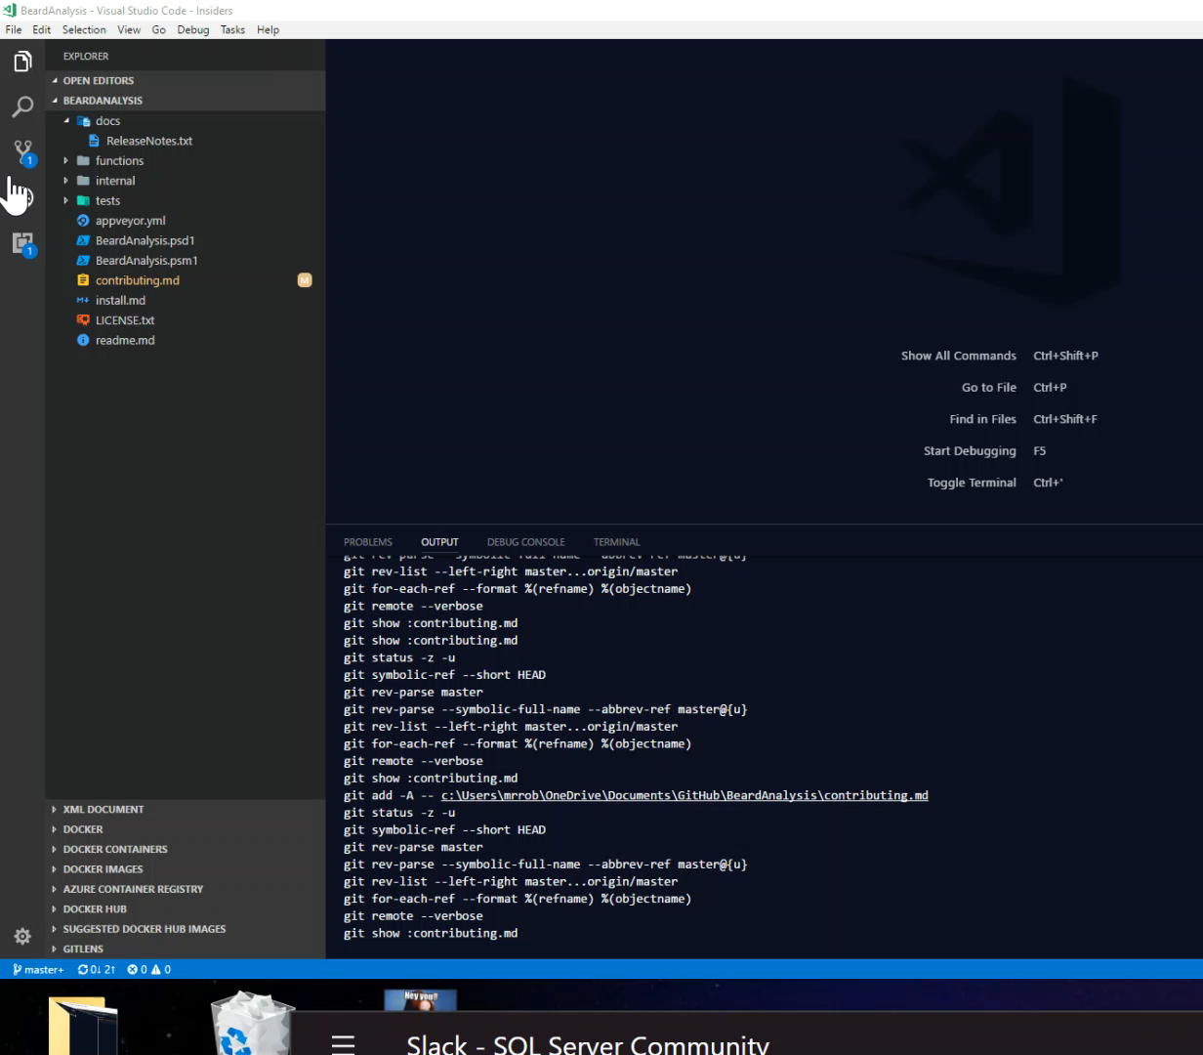
Git
Rob Sewell @sqldbawithbeard https://sqldbawithAbeard.com RobSewell.Info
Notes:
I love using VS Code to work with Source control – so easy

Slide 13
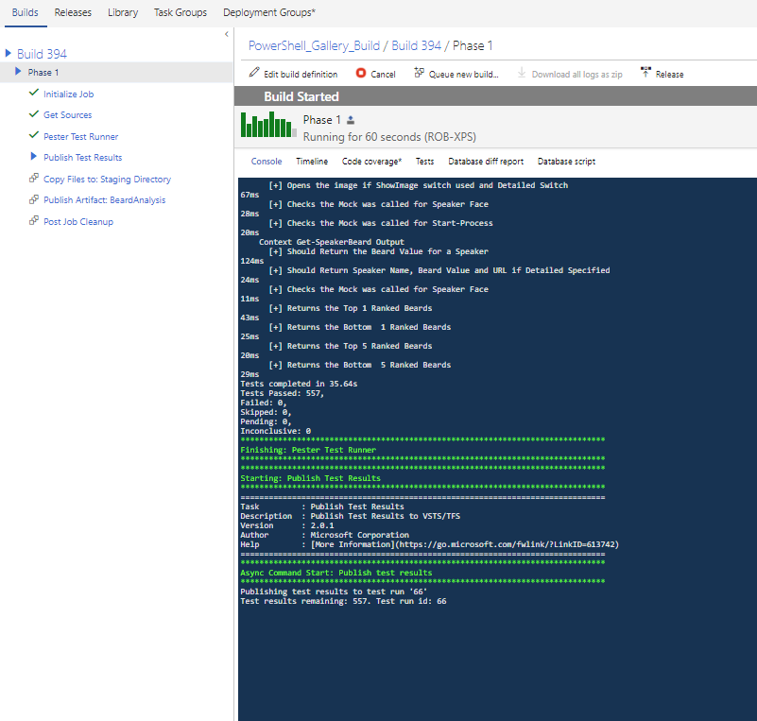
VSTS Build
Rob Sewell @sqldbawithbeard https://sqldbawithAbeard.com RobSewell.Info
Notes:
Our build gets triggered by a commit
It runs the Pester tests in the tests folder and publishes the results

Slide 14
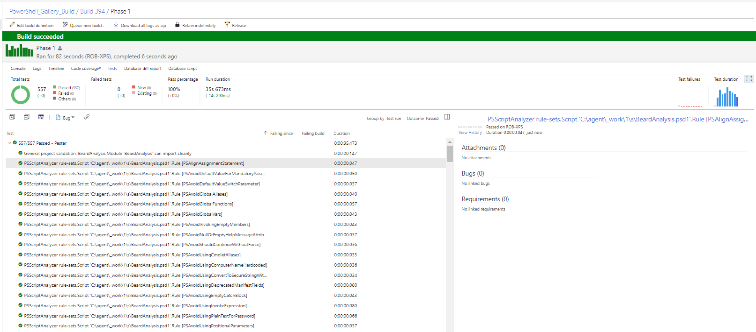
VSTS Build
Rob Sewell @sqldbawithbeard https://sqldbawithAbeard.com RobSewell.Info
Notes:
Here is our successful build results page with the Pester tests and graphs

Slide 15
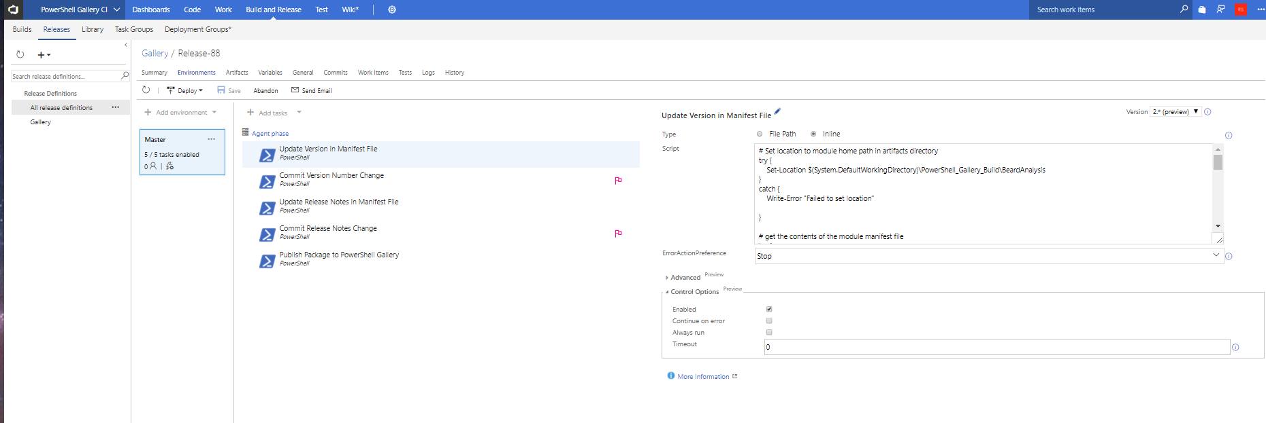
VSTS Release
Rob Sewell @sqldbawithbeard https://sqldbawithAbeard.com RobSewell.Info
Notes:
Our Release triggers on successful build
It increments the Module version and adds the release notes
Requires a Personal Access Token from Git to commit those changes

Slide 16
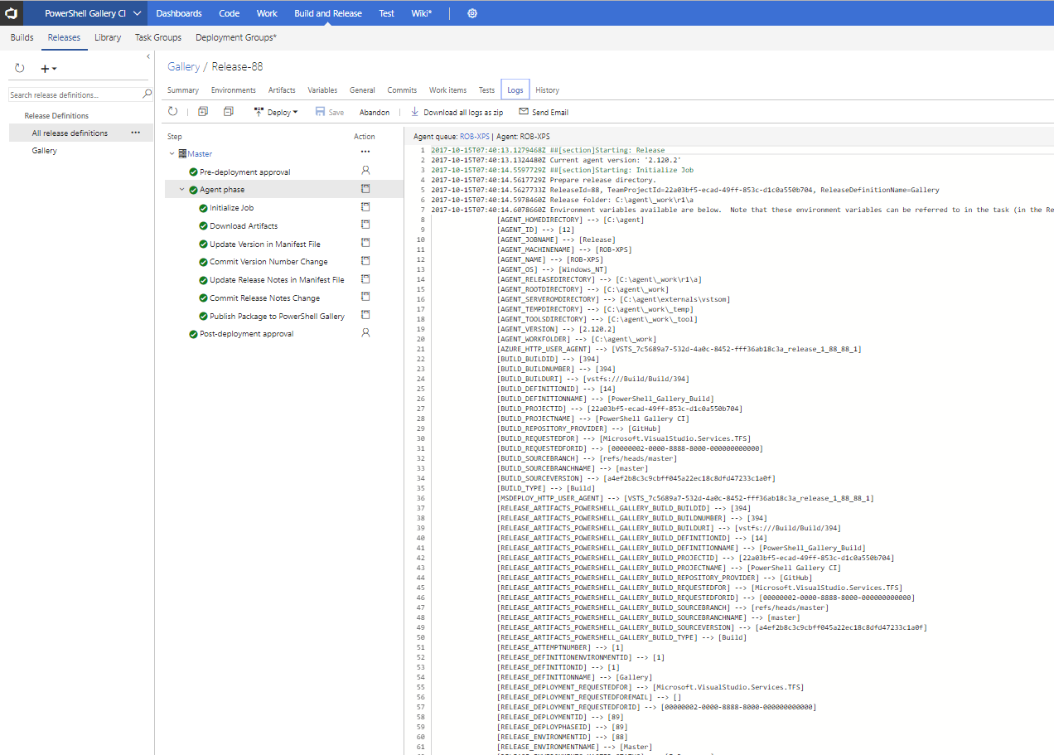
VSTS Release
Rob Sewell @sqldbawithbeard https://sqldbawithAbeard.com RobSewell.Info
Notes:
It then Publishes the module to the PowerShell (or internal ) Gallery
Once the release has completed you can examine the logs

Slide 17
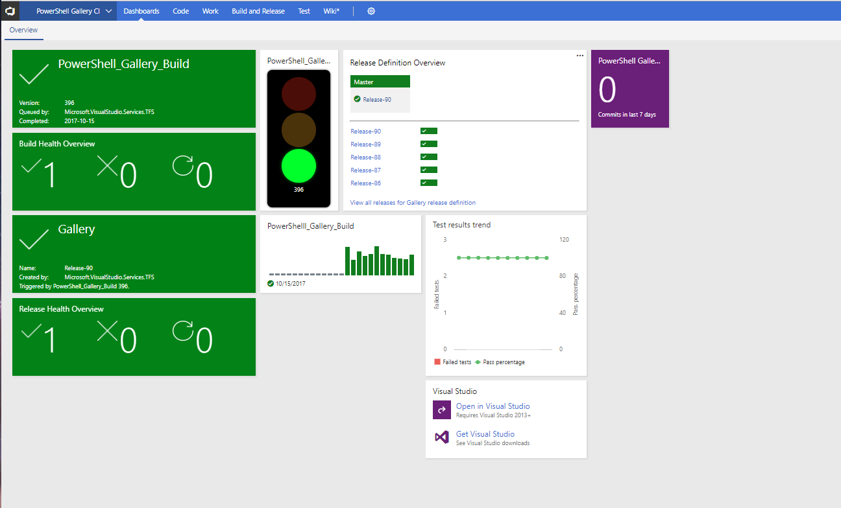
VSTS DashBoard
Rob Sewell @sqldbawithbeard https://sqldbawithAbeard.com RobSewell.Info
Notes:
We have a nice pretty dashboard so everyone can see what is happening and also we could provide authroisation steps if we need to

Slide 18
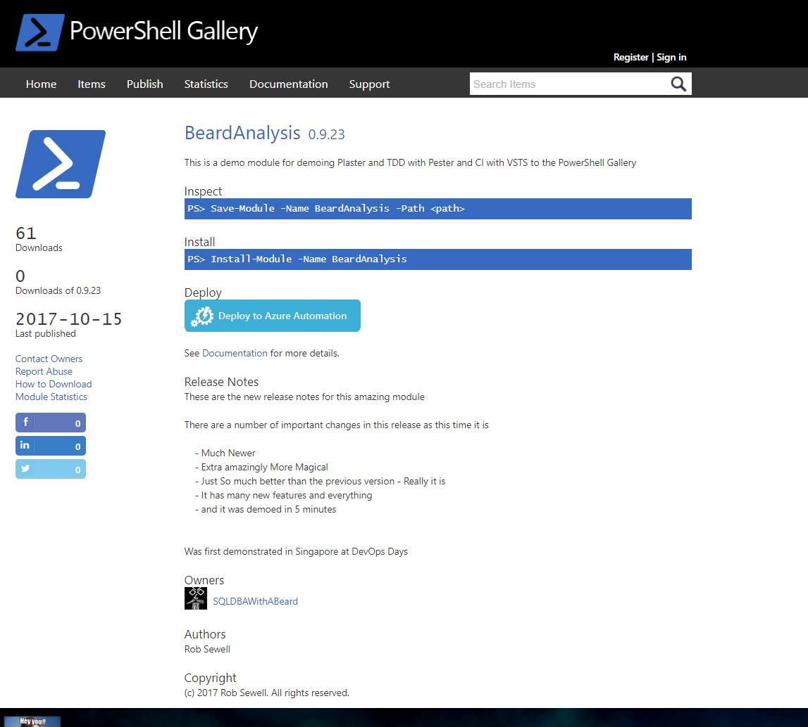
PowerShell Gallery
Rob Sewell @sqldbawithbeard https://sqldbawithAbeard.com RobSewell.Info
Notes:
Now we have our updated module in the gallery
With the release notes

Slide 19
Summary
Continuous Delivery of PowerShell Module to the Gallery is easy Plaster can template your module framework
Pester is a Unit Testing Framework for PowerShell
VSTS is free
Have Fun – Create some modules today
Rob Sewell @sqldbawithbeard https://sqldbawithAbeard.com RobSewell.Info

